Slide 1
IDS and Malicious Attack Simulator
Presented by:
Yahia Saleh AG1411
Ali Nabil AD0497
Hussam abzakh AE0801
Basel Al’jbarat AE1369
Supervised By:
Dr.Shadi Almasadeh

Slide 2
TABLE OF CONTENTS
01
02
03
04
05
06
Introduciton
The Problem&Purpose
OUR GOALS
Key Enhanced & Innovaitons
System Architecture
Real-Time Visibility
07
Conclusion & Future Work

Slide 3
01.
Introduciton
01.00 IDS
01. 10 IDS and Malicious Attack Simulator

Slide 4
IDS
An Intrusion Detection System (IDS) is a vital component of modern cybersecurity infrastructure.
Designed to monitor network traffic or system activity for signs of malicious behavior or policy violations, an IDS functions as a digital sentinel—constantly analyzing and alerting against potential threats.
Unlike firewalls, which act as gatekeepers to block unauthorized access, IDS solutions focus on identifying and reporting suspicious activities that have penetrated or originated within the network.
01.00

Slide 5
IDS and Malicious Attack Simulator
This project delivers a complete cybersecurity solution that not only detects network threats but also tests and validates its own effectiveness.
The first core component is an advanced Intrusion Detection System (IDS). Unlike basic systems that rely only on known attack signatures, this IDS uses smarter techniques—like tracking TCP connection states, analyzing high-volume UDP traffic, and inspecting payload data. This allows it to catch a wide range of attacks, including port scans, brute-force logins (like SSH and FTP), and web vulnerabilities such as SQL Injection and XSS.
The second key component is a built-in Attack Simulator. It can safely launch realistic attacks on demand—from reconnaissance and login attempts to web-based exploits. This makes it easy to test the IDS in real-time and fine-tune its accuracy.
Together, the IDS and simulator form a self-testing, closed-loop system. As threats are simulated and detected, the system constantly validates and improves itself—giving security teams clear, immediate proof of what works and what needs adjustment.
01.10

Slide 6
The Problem & Purpose
The Problem
The Purpose
Proactive Threat Detection
Develop an intelligent Intrusion Detection System (IDS) capable of identifying a broad range of malicious activities—including port scans, brute-force attacks, and web application exploits—with high accuracy and low false positives.
Realistic Attack Simulation
Develop a Malicious Attack Simulator that can safely replicates real-world cyberattacks in a controlled environment. This allows for ongoing testing, validation, and fine-tuning of the IDS, ensuring it performs reliably under realistic threat conditions.
Modern networks are under constant pressure from increasingly advanced cyber threats.
While many detection systems claim to identify these attacks, their true effectiveness is often unknown.
Without a way to systematically test and validate these tools, organizations may be left exposed—either by missing real intrusions or by wasting time on false alarms.
02.00

Slide 7
OUR GOALS
Detect a Wide Range of Threats Accurately
Design and implement a multi-layered detection engine capable of identifying various types of malicious activity.
Minimize False Positives Through Smart Detection
To use intelligent, context-aware analysis to ensure alerts are meaningful and reliable.
Provide Real-Time Visibility with a Monitoring Dashboard
Develop an intuitive, web-based dashboard that offers:
Real-time security alerts
Traffic statistics and visualizations
A centralized view for administrators to monitor and respond to incidents quickly
Build a Self-Testing, Validated Security Framework
To create a built-in attack simulator to reliably test, prove, and demonstrate the IDS's effectiveness.
03.00

Slide 8
Key Enhanced & Innovaitons
Smarter Detection, Fewer False Alarms
Advanced Threat Recognition
Tracks TCP connection states to reduce false positives
Adapts to high-volume traffic like streaming to avoid false DoS alerts
Detects stealthy scan types (FIN, NULL, XMAS)
Analyzes web payloads to uncover hidden attacks like SQLi and XSS
User-Friendly Management
Built-In Validation
Real-time web dashboard with alerts, stats, and filtering
Easy rule customization via YAML—no code changes needed
Integrated attack simulator enables safe, realistic testing
Ensures the IDS can detect real-world threats reliably
04.00

Slide 9
System Architecture Overview
Our IDS uses a modular, multi-layered design for efficient, real-time threat detection. Each component is independent but tightly integrated, ensuring performance, scalability, and clarity.
Packet Sniffer & Initial Filtering | 🛠 Technology: Scapy 🎯 Function: Captures real-time traffic on the selected interface using sniff(). Applies Berkeley Packet Filter (BPF) to capture only relevant protocols (TCP, UDP, ICMP). Reduces system load with early traffic filtering.
Central Analysis Engine | ⚙️ Function: Directs each packet to the correct detection module. Skips whitelisted IPs Routes TCP/UDP/ICMP traffic to protocol-specific detectors
Detection Modules (Intelligence Layer) | Each module specializes in identifying specific threats: 🔍 PortScanDetector – Detects SYN, FIN, NULL, XMAS scans 🔐 BruteForceDetector – Tracks login attempts on SSH/FTP 🌊 DoSDetector – Monitors per-IP packet rates; distinguishes attacks from streaming 🌐 WebAttackDetector – Analyzes HTTP payloads for SQLi, XSS, etc. 🧠 AnomalyDetector – Learns normal patterns, flags unusual behavior
05.00

Slide 10
System Architecture Overview
Alerting & Logging Framework | 📢 Function: Handles threat alerts and logging Assigns severity levels (Critical, High, Medium, Low) Applies False Positive Scoring Logs to professional_ids.log Pushes alerts to dashboard in real-time via a high-speed queue
Web Dashboard | 🌐 Technology: Flask Web Framework 💡 Function: Provides a live, user-friendly interface Backend: Flask serves APIs for alerts, stats Frontend: Auto-refreshing dashboard with charts, logs, filters User View: Real-time visibility into system behavior and threats
05.00

Slide 11
Real-Time Visibility
1• Web Dashboard:
Centralized Command & Control
A real-time, web-based interface that gives a complete view of your network's security posture—including live results from simulated attacks.
Key Features:
📊 Live Statistics
Total packets processed
Packets per second
Number of active alerts
📈 Traffic Analysis Charts
Protocol distribution (TCP, UDP, ICMP, etc.)
Hourly traffic trends and spikes
🚨 Live Alert Feed
Searchable, filterable table of security events
Includes timestamps, severity levels, and event details
06.00

Slide 12
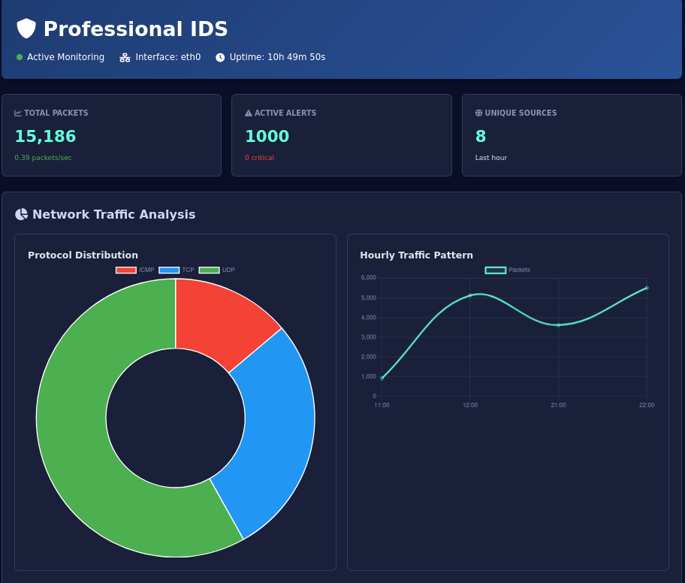
Web Dashboard
06.10

Slide 13
Real-Time Visibility
2• Attacks Simulation:
06.20

Slide 14
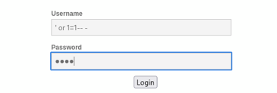
Real-Time Visibility
Scenario 1: Web Attacks (SQL Injection) Execution: SQL Injection payload were entered into the form.
Result: The IDS detect these patterns using predefined signatures and give an alert as High severity
06.21

Slide 15
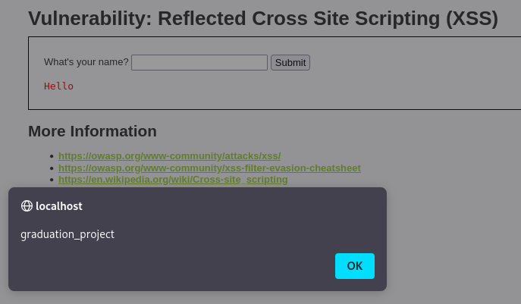
Real-Time Visibility
Scenario 2: Web Attacks (XSS Injection) Execution: XSS Injection payload were entered into the form.
Result: The IDS detect these patterns using predefined signatures and give an alert as High severity
06.22

Slide 16
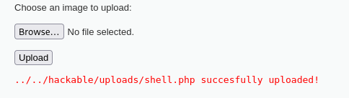
Real-Time Visibility
Scenario 3: Web Attacks (Malicious File Upload Detection) Execution: This alert indicates a malicious file upload attempt where a payload (likely a web shell) was sent through upload function.
Result: The IDS analyzes the uploaded file's name and content, detecting a threat and give an alert as critical severity.
06.23

Slide 17
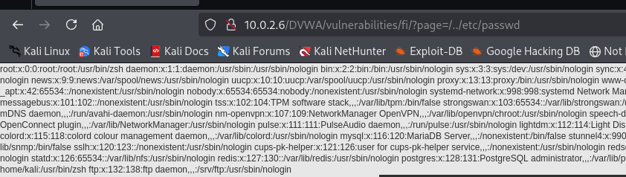
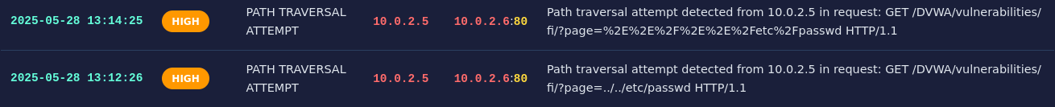
Real-Time Visibility
Scenario 4: Web Attacks (Path Traversal ) Execution: Tried accessing sensitive files using encoded and direct traversal strings like “../../etc/passwd”.
Result: The IDS detect these patterns using predefined signatures and give an alert as HIGH severity
06.24

Slide 18
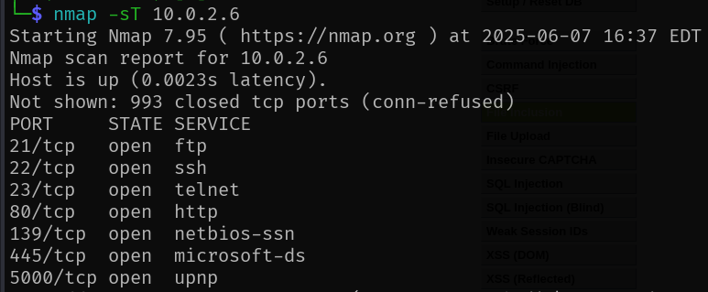
Real-Time Visibility
Scenario 5: Ports Scanning Detecting Port scanning is a technique used to identify open ports and services running on a target machine. Execution: A standard TCP connect scan was executed using nmap to probe the IDS machine for open ports.
06.25

Slide 19
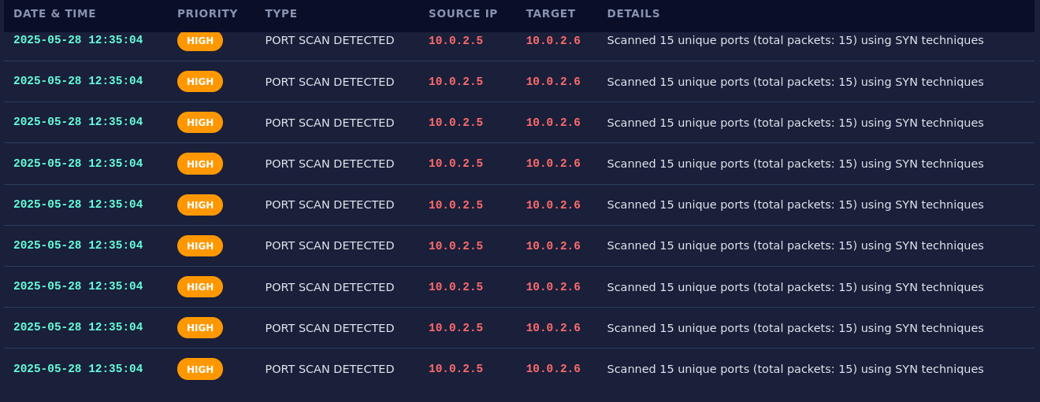
Real-Time Visibility
Result: The IDS detects a coordinated port scan by observing a single source IP attempting to connect to a high number of unique ports in a short time frame. By analyzing the packets' TCP flags, the system identifies the specific technique used (e.g., SYN Stealth Scan) and give an alert as HIGH severity.
06.25

Slide 20
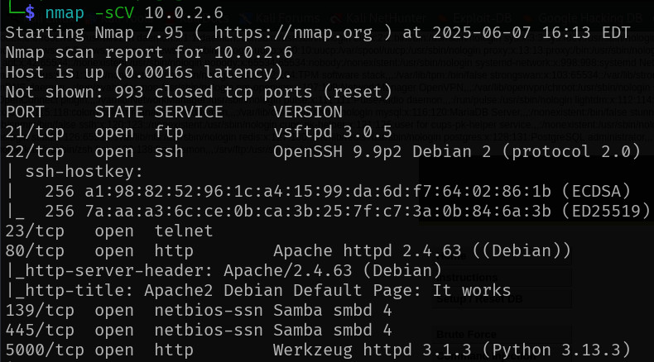
Real-Time Visibility
Scenario 6: Anomaly Detection Stealth port scanning is a technique used to identify open ports and services running on a target machine.
06.26

Slide 21
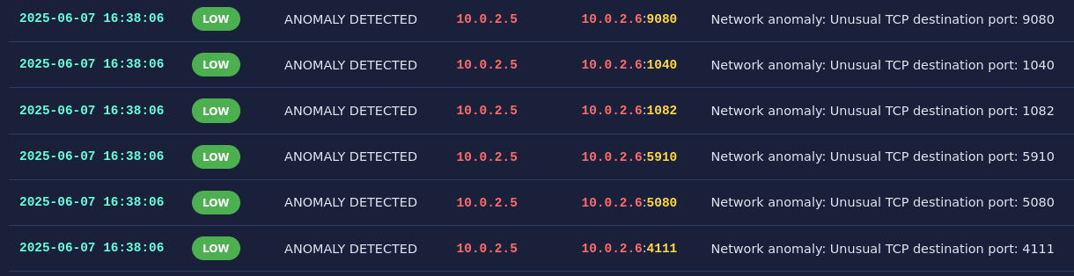
Real-Time Visibility
Result: The IDS detects behavior that deviates from the established network baseline and give an alert as Low severity
06.26

Slide 22

Real-Time Visibility
Scenario 7: Brute Force Attack
A brute-force attack is a common method used by attackers to gain unauthorized access to a service by systematically guessing login credentials.
Result: The IDS immediately detects the attack by monitoring the rapid succession of failed login attempts originating from the same IP address. Once the number of failures crosses a predefined threshold within a short time window, the system identifies it as a brute-force attempt. It raises an alert with High severity to signal an active and direct attempt to login to the server.
06.27

Slide 23
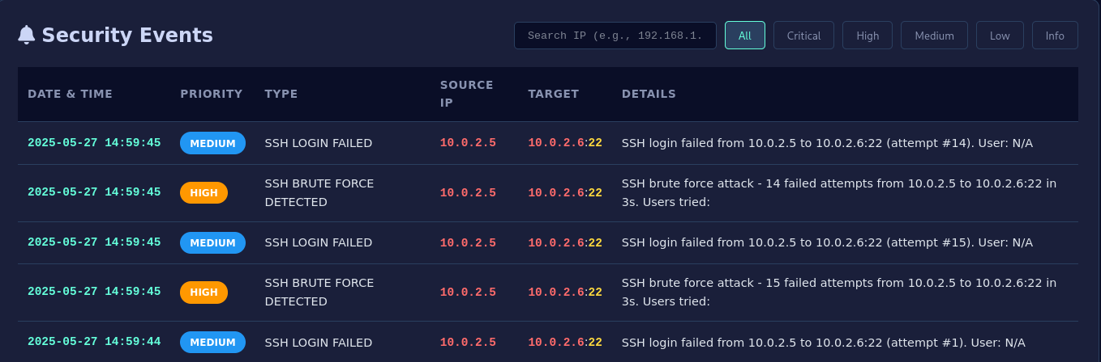
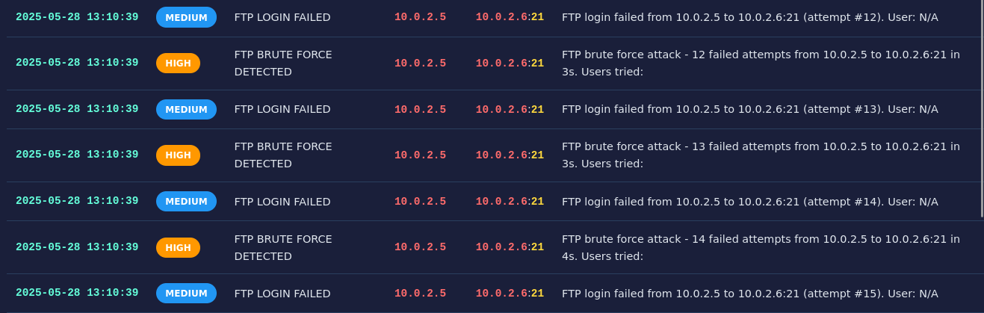
Real-Time Visibility
06.27

Slide 24
Conclusion & Future Work
Summary of Achievements
Our project successfully met its key goals, delivering a robust and innovative cybersecurity framework:
Comprehensive Threat Detection: Developed a multi-layered engine capable of accurately detecting a wide range of malicious activities.
High-Fidelity Alerting: Implemented intelligent, context-aware analysis to reduce false positives and generate meaningful alerts.
Real-Time Monitoring: Built a user-friendly web dashboard for live visibility into network security events.
Self-Validating System: Integrated a built-in Attack Simulator, enabling continuous testing and validation of defenses.
07.00

Slide 25
Conclusion & Future Work
Future Enhancements
To build on this success, future development could focus on:
Machine Learning Integration: Use ML models to detect anomalies and previously unseen threats more effectively.
Automated Intrusion Prevention: Add active response capabilities to transition from detection (IDS) to prevention (IPS).
Expanded Threat Library: Regularly update attack signatures and simulation scenarios to match evolving threat landscapes.
Scalability Improvements: Enhance system architecture to support larger-scale traffic, multiple interfaces, or distributed environments using parallel processing.
07.00

Slide 26
OUR TEAM
Yahia Saleh
Basel Al’jbarat
Ali Nabil
Supervised By:
Dr.Shadi Almasadeh
Hussam abzakh

Slide 27
IDS
THANKS

